Slide 1

FPGA-Based hardware/software co-design of a bio-inspired sat solver
ANH HOANG NGOC NGUYEN , MASASHI AONO , AND YUKO HARA-AZUMI , (Member, IEEE)
ΠΑΠΠΑΣ ΓΙΩΡΓΟΣ – ΕΦΡΑΙΜ

Slide 2
Introduction
Internet of Things is an ever-growing technology in which a huge number of edge devices trying to share information with each other and control a target object in their own applications.
IoT applications seek for solutions to combinatorial optimization problems.
As the solutions/decisions should be resolved at the edge devices, problem solvers need to feature:
Scalability in searching time
Lightweight operations
Applicability to various kinds of IoT applications
An example (the state-of-the-art) of such a problem solver is AmoebaSAT. (SAT: Satisfiability problem)

Slide 3
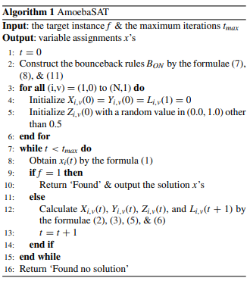
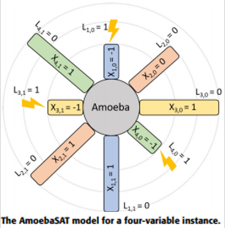






AmoebaSAT: Amoeba-Inspired SAT solver algorithm
Pseudocode
Satisfiability (SAT): determining the existence of a solution to a given formula -> solution is a variable assignment that is said to satisfy it.
Boolean satisfiability problem: determines whether or not a Boolean formula could be satisfied.
(Example: f = (x1 ∨ x2) ∧ (x1 ∨ x2), is satisfied (f=1) when (x1, x2) ∈ {(0, 1), (1, 1)}

Slide 4
Bounceback rules
Li,v is the way of AmoebaSAT algorithm of learning from its mistakes.
Li,v is the bounceback control signal that cuts off the resource supply on the units needed, thus making them retract in the next iteration based on the rules:
INTRA: Variable xi can only be either 0 or 1 in a given iteration. The units Xi,0 and Xi,1 cannot be supplied at the same time.
INTER: In the clause C = (x1 ∨ x2 ∨ x3) if x1=x2=0, x3 should be set to 0, to keep the clause true, so while the unit (3, 0) should be expanded, the unit (3,1) should be bounced back to avoid the contradiction.
CONTRA: Manages the contradiction between multiple units from deferent clauses. For example, for the 2 clauses C1=(x1 v x2) C2=(x3 v x2), x2 needs to be both 0 and 1 to satisfy both clauses, which will lead to the bounceback of both X2,0 and X2,1, which is an undesired behavior.

Slide 5
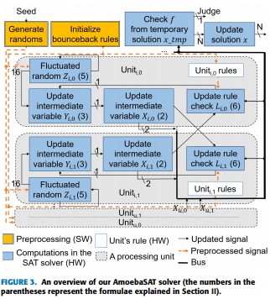
FPGA-based AmoebaSAT
FPGA-based AmoebaSAT is realized in a hardware/software co-design
manner as described in the right picture.
Construction of the bounceback rules, as well as random initialization for
Z’s are realized as a software pre-processing component and performed
only once at the beginning of the computation.

Slide 6
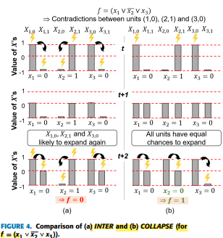
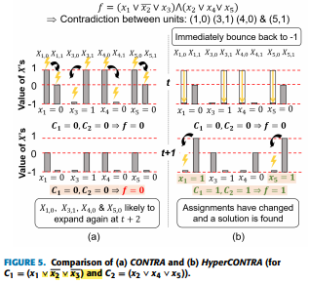
Software – level optimizations
In order for the algorithm to converge toward a solution faster, it is proposed in the paper to:
Firstly to add COLLAPSE bounceback rule ◦ Secondly replace CONTRA with HyperCONTRA

Slide 7
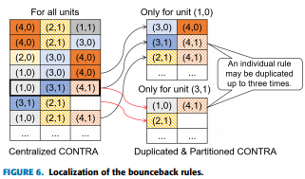
Hardware – aware design optimizations
A. Operational types and definition
Floating-to-fixed-point conversion to Z’s (Z  (0.0,1.0))
Minimized bitwidth of the other variables (2 bits for X’s and 1 for the others)
Replaced logistic map with a tent map for Z’s oscillation.
Logistic map uses multiplier (needs several DSPs)
Tent map is realized by a shifter only
B. Rule localization
Bounceback rules partially duplicated so that each unit has its related rules in the local lookup table
For an instance composed of N variables and M clauses, the proposed implementation has 2N separate units, each one of which has its own rules, due to rule localization.

Slide 8
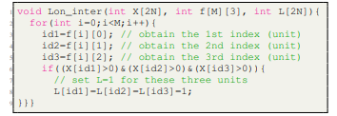
Hardware – aware design optimizations
C. Loop optimizations
Issues:
Write-After-Read dependencies:
a. Old values of L’s needed to update Y’s
This WAR dependency is only within a unit
b. In order to check satisfiability we need old x’s. Then, we can update.
This WAR dependency relates to all units -> satisfiability can only be done after all x’s are updated
Irregular memory accesses ->access patterns on the variables/arrays are not statically analyzable.
Sequential access limitation to FPGA built-in memories.
Solutions:
Removed dependencies using Vivado HLS pragma “dependence false”
Temporary array xtmp to resolve x’s WAR
Pragma “array_partition complete dim=0” (So we achieved pipeline II=1 at the cost of resource utilization)

Slide 9
Experiments and results
Testing setup:
4 versions of the proposed AmoebaSAT solver
Ours-B: AmoebaSAT with the original bounceback rules as the baseline
Ours-C: AmoebaSAT with original bounceback rules + COLLAPSE
Ours-H: AmoebaSAT with original bounceback rules + HyperContra
Ours-CH: AmoebaSAT + Collapse + HyperContra
Compared to:
Original AmoebaSAT as software (SW)
Hardware AmoebaSAT solver – simplified (ISQED)
Hardware WalkSAT solver (WalkSAT)
Initialization part of Ours-B/C/H/CH and SW were evaluated on a Cortex-A9 of the same Zynq board at 1Ghz

Slide 10
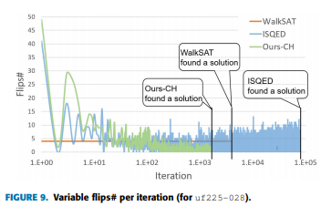
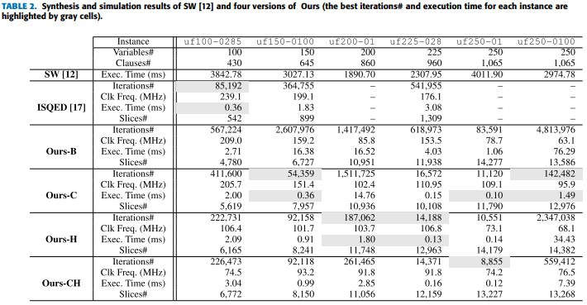
Experiments and results
1ST Evaluation set (SATLIB benchmark):
6 randomly generated instances of 100-250 variables
(Sw runs at
processor core
with 5-13x higher
clock frequency)
In all solvers the frequency degrades for larger instances as interunit wires tend to be critical and get longer
ADP=Slice#*Exec_Time

Slide 11
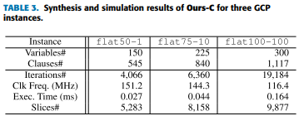
Experiments and results
2nd Evaluation set
Real life evaluation set: SAT-encoded flat graph colouring instances of 150 to 300 variables.
The execution time results show that this algorithm could be used to a 5G scheduling problem to a 50 node network (exec time<<1ms)

Slide 12
Conclusion
In this paper it was proposed an FPGA-based AmoebaSAT solver utilizing a hardware/software co-design approach
The sequential part of the algorithm took part on the FPGA built-in microprocessor (to exploit the high clock frequency)
The parallel computation part was realized as hardware to extract the parallelism of the algorithm.
Both software and hardware optimization techniques were applied to converge faster to a solution.
Maybe with machine learning techniques we could achieve better rule utilization and converge to a solution faster..?

